Slide 1
TERMS AND CONDITIONS
These PowerPoint slides are a tool for lecturers, and as such:
YOU MAY add content to the slides, delete content from the slides, print out the slides, and save the slides onto your computer or server.
YOU MAY NOT resell, reproduce or redistribute the content in any form whatsoever, without prior written permission from the copyright holder.
© Troupant Publishers (Pty) Ltd, 2016
Selected images used under licence from Shutterstock.com

Slide 2
Engineering Systems
NQF Level 2

Slide 3
Performing routine maintenance
Module 16

Slide 4
Performing routine maintenance
Unit 16.1

Slide 5
Routine maintenance checklist
Always turn off the power to the drive. Lock and tag control box.
Make sure the power is turned off for the correct drive.
Test to make sure the correct circuit has been turned off.
Place all machine components in a safe position.
Remove the guard and inspect for damage.
Check for signs of wear or rubbing against drive components.
Clean and realign the guard to prevent rubbing if necessary.

Slide 6
Routine maintenance checklist
Figure 16.1 A tag-out card

Slide 7
Routine maintenance checklist
Inspect the belt for wear or damage. Replace if necessary.
Inspect sheaves or sprockets for wear and misalignment. Replace if worn.
Inspect other drive components such as bearings, shafts and motor mountings.
Check the belt tension and adjust as needed.
Recheck the sheave or sprocket alignment.
Reinstall the belt guard.
Turn the power back on and restart the drive. Look and listen for anything unusual.

Slide 8
Routine maintenance procedure
Inspecting a belt
Mark or note a point on the belt or on one of the belts in a multiple V-belt drive.
Wearing gloves, work around the belt, checking for cracks, frayed spots, cuts or unusual wear patterns.
Check the belt for exposure to excessive heat.

Slide 9
Routine maintenance procedure
Inspecting a belt
Rubber belts that are running hot or running in a hot environment will harden and develop cracks from the bottom of the belt upwards.
Replace belts if there are obvious signs of cracking, fraying, unusual wear or loss of teeth.

Slide 10
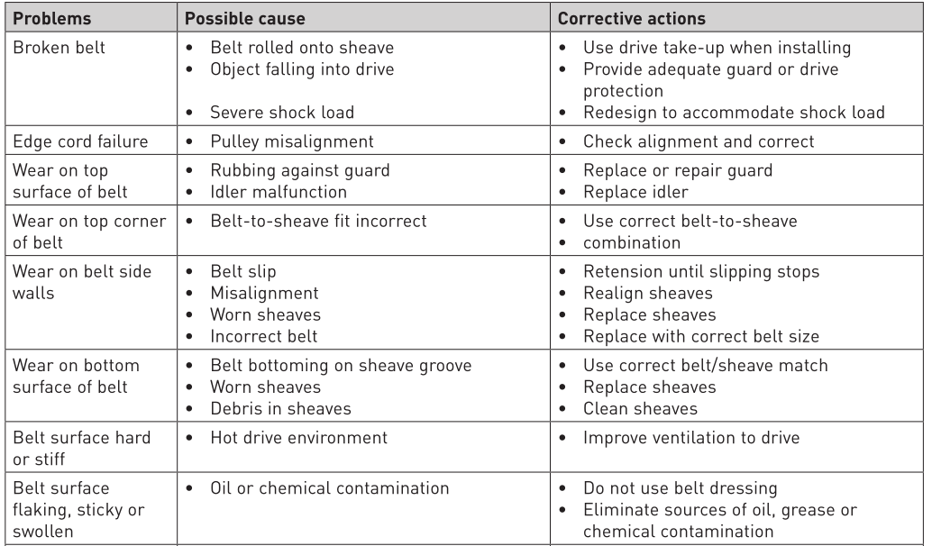
Inspecting a belt
Table 16.1 Some common problems associated with belts, possible causes and corrective actions

Slide 11
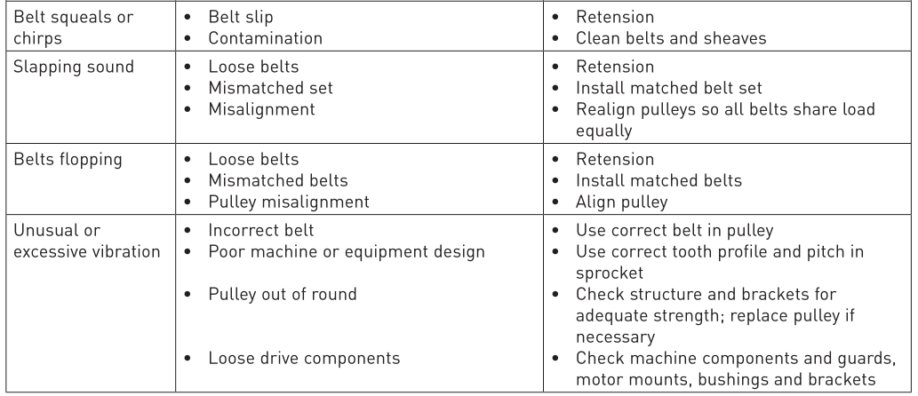
Inspecting a belt
Table 16.1 Some common problems associated with belts, possible causes and corrective actions (continued)

Slide 12
VIDEO: Thobejane today

Slide 13
Routine maintenance procedure
Checking alignment
Place the straight edge along the outside face of both sheaves or sprockets. If the drive is properly aligned, the straight edge will touch each sheave or sprocket evenly.
Misalignment of sprockets and shafts will show up as a gap between the outside face of the sheave or sprocket and the straight edge.
Check for tilting or shaft misalignment by using a bubble level.

Slide 14
Routine maintenance procedure
Checking alignment
The three possible causes of sheave or sprocket misalignment:
Angular misalignment.
Parallel misalignment.
Sheaves or sprockets are tilted.

Slide 15
Routine maintenance procedure
Inspecting a guard
Rotate the drive two or three revolutions by hand and check the belt tension. If necessary, retention the belt and make a final alignment check.
If V-belts are under-tensioned, they can slip. Slippage generates heat and will result in cracking and belt failure.

Slide 16
Routine maintenance procedure
Inspecting a guard
If synchronous belts are under-tensioned, they can jump teeth or ratchet.
If belts are over-tensioned, belt and bearing life can be reduced.

Slide 17
Routine maintenance procedure
Installing belts
Preparation:
Confirm that the power is off, locked and tagged.
Wear proper PPE – hardhat, gloves, safety glasses and safety shoes.
Remove the belt guard and place it away from the drive so that it.
Does not interfere with work on the drive.

Slide 18
Routine maintenance procedure
Installing belts
Removing the old belt:
Loosen the motor mounting bolts or adjusting screws.
Move the motor in until the belt is slack and can be removed easily without prying.
Inspect the old belt for any unusual wear.

Slide 19
Routine maintenance procedure
Installing belts
Removing the old belt:
Inspect the sheaves or sprockets for unusual or excessive wear.
For V-belt sheaves, inspect the grooves for wear and nicks.

Slide 20
Routine maintenance procedure
Installing belts
Installing new belts and sheaves or sprockets:
If necessary, install new sheaves or sprockets.
Check the sheave or sprocket alignment.
Adjust the sheave or sprocket position as necessary.
Install the new belt or set of belts.

Slide 21
Routine maintenance procedure
Installing belts
Installing new belts and sheaves or sprockets:
Replace all belts on multiple V-belt drives.
Use belts from the same manufacturer on a multiple belt drive.
When installing the belt, make sure that there is clearance to slip the belt over the sheave or sprocket.
Check belt tension using a tension gauge.

Slide 22
Routine maintenance procedure
Installing belts
Installing new belts and sheaves or sprockets:
Adjust the belt drive’s centre distance until the correct tension is measured.
Rotate the belt drive by hand for a few revolutions.
Recheck the belt tension and adjust as necessary.
Recheck the drive alignment and adjust as necessary.

Slide 23
Routine maintenance procedure
Installing belts
Completing the installation:
Secure the motor mounting bolts and tighten to the correct torque.
Recheck the belt tension and adjust as necessary as tightening the motor mounting bolts may have changed the belt tension.
Replace the belt guard.

Slide 24
Routine maintenance procedure
Installing belts
Completing the installation:
Start the drive, looking and listening for any unusual noise or vibration.
If possible, shut down the drive and check the bearings and motor for unusual heat.

Slide 25
Routine maintenance procedure
V-belt run-in procedure
After you have run the belts, stop the belt drive and check the belt tension.
Running the belts under full load will seat the V-belts into the sheave grooves. V-belt tension will drop after the initial run-in and seating process – this is normal. Adjust the belt tension as necessary.

Slide 26
Routine maintenance procedure
V-belt run-in procedure
Since tension in V-belts will drop after the initial run-in and seating process, failure to check and retention the belt will result in low belt tension and belt slippage. This slippage will result in premature belt failure.

Slide 27
Routine maintenance procedure
Storage recommendations
Recommended storage procedures:
Store belts in a cool, dry environment with no direct sunlight.
Store belts in their individually.
Store V-belts by hanging them on a wall rack if they are hung on a saddle.

Slide 28
Routine maintenance procedure
Storage recommendations
Recommended storage procedures:
When the belts are stored, they must not be bent to diameters smaller than the minimum recommended sheave or sprocket diameter for that belt.
If stored in a container, make sure that the belt is not distorted when in the container.

Slide 29
Routine maintenance procedure
Storage recommendations
Recommended storage procedures:
Limit the contents in a container so that the belts at the bottom of the container are not damaged by the weight of the rest of the belts in the container.

Slide 30
Routine maintenance procedure
Storage recommendations
Storage procedures that are not recommended:
Do not store belts near windows where they may be exposed to direct sunlight or moisture.
Do not store belts near heaters or in the direct airflow of heating devices.
Do not store belts where they are exposed to solvents or chemicals in the atmosphere.
Do not store belts on the floor.

Slide 31
Routine maintenance procedure
Reducing noise
Properly tensioning and aligning a belt drive will allow the belt drive to perform at its quietest level.
Incorrect tension in synchronous belt drives can affect how the belt fits in the sprocket grooves.
Misaligned V-belt drives will be noisier than properly aligned drives since interference is created at the belt’s entry point into the sheave.

Slide 32
Routine maintenance procedure
Reducing noise
Misaligned synchronous belt drives tend to be much noisier due to the even greater amount of interference that is created between the belt teeth and the sprocket grooves.

Slide 33
Oil and lubricants
Oil lubrication.
Grease lubrication.
Hydraulic oil.

Slide 34
Maintenance procedure
Table 16.2 An example of a routine maintenance procedure for a hydraulic system

Slide 35
Maintenance procedure
Table 16.2 An example of a routine maintenance procedure for a hydraulic system (continued)

Slide 36
Maintenance procedure
Figure 16.2 Circuit diagram of a hydraulic system

Slide 37
Starting up and shutting down machinery
Start-up and shut-down procedures of machines differ depending on the complexity of the machine and its operation.

Slide 38
Starting up and shutting down machinery
Figure 16.3 Start and stop button
Figure 16.4 Start and stop buttons

Slide 39
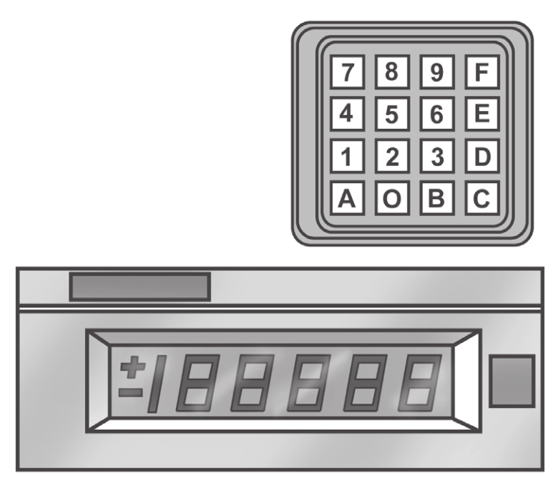
Starting up and shutting down machinery
Figure 16.5 Keypad and digital display unit

Slide 40
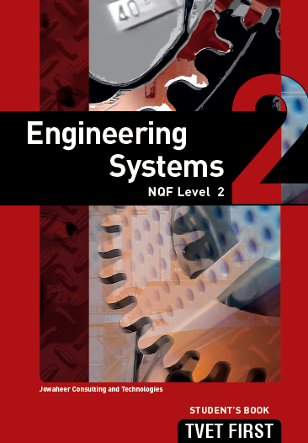
Summative assessment
Test your knowledge of this section by completing the Summative assessment (page 259 of your Student’s Book)

